Slide 1
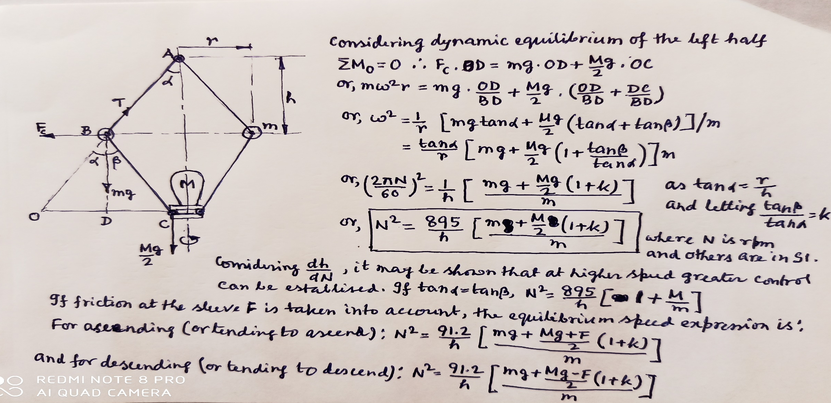
Porter Governor
For a Watt governor, at higher speed range the change in governor height significantly decreases due to any speed variation; as a result the lift of the sleeve also decreased and control over input becomes inaccurate. This limitation of Watt governor is overcome in Porter Governor where, apart from the fly-mass m, an additional sleeve mass M is added to the governing system. Here, depending on the higher speed range, a suitable ratio of M/m can be chosen so that an effective control over the input can be established.

Slide 2
Problems on Governor
Prove that, for any particular configuration, the height of the Watt governor is inversely proportional to the square of the equilibrium speed.
Prove that, for any particular configuration, the equilibrium speed of the Watt governor is independent of the value of its fly-mass.
Derive the equilibrium speed expression for a Porter governor. Hence quantitatively show that for a higher speed range a greater control over the input can be established by the Porter governor when compared to a Watt governor.
Each arm of a Porter governor is 200 mm long and is pivoted on the axis of the governor. The radii of rotation of the balls at the minimum and maximum speeds are 120 mm and 160 mm respectively. The mass of the sleeve is 24 kg and each ball is 4 kg. Find the range of speed of the governor. Also, determine the range of speed if the friction on the sleeve is 18 N.
The arms of a Porter governor are 30 cm long. The upper arms are pivoted on the axis of rotation while the lower arms attached to the sleeve at an offset of 4 cm from the axis. If ball mass is 10 kg and sleeve mass is 70 kg, determine the equilibrium speed at the lowest position of the sleeve when the governor radius is 20 cm. If, now, friction at the sleeve is equivalent to 25 N is assumed, what will be the speed range of the governor for a lift of the sleeve of 6 cm?

